Slide 1
Chapter 2: Some Representative Pesticides

Slide 2
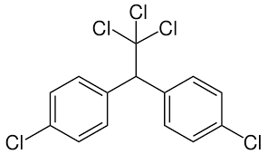
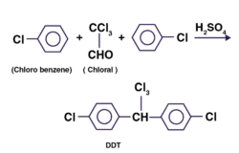
Organochlorines
DDT (Dochloro-diphenyl-trichloroethane)
Synthesis of DDT

Slide 3
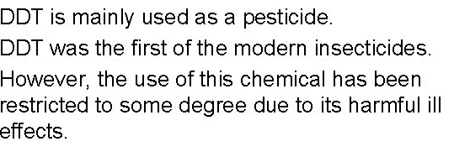
Uses of DDT

Slide 4
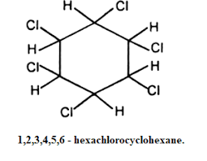
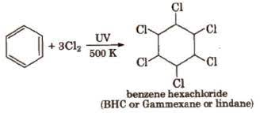
Gammexane or BHC
Synthesis of Gammexane

Slide 5
Uses of Gammexane:
It kills or controls insects, grass hoppers and common pests.
It is used in the form of dust containing 5-10% of the ingredients in emulsion containing 25% of the gamma isomer.

Slide 6
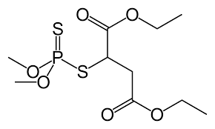
Organophosphates
Affects non-target species
Affect the nervous system
Effects are usually reversible
Highly toxic
Not as persistent in the environment
Malathion

Slide 7
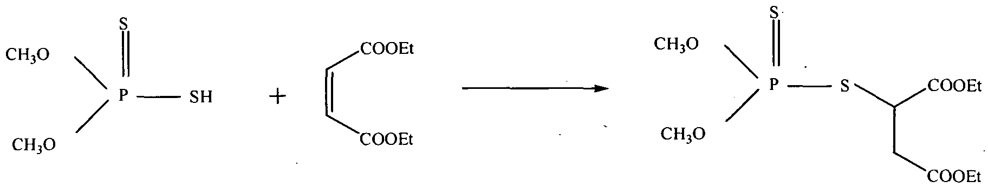
Synthesis of malathion
Uses
Used widely in agriculture.
Effective against mosquitoes, flies and external parasites.
Used as fungicide as well as rat repellant.
Used to treat lice in humans.

Slide 8
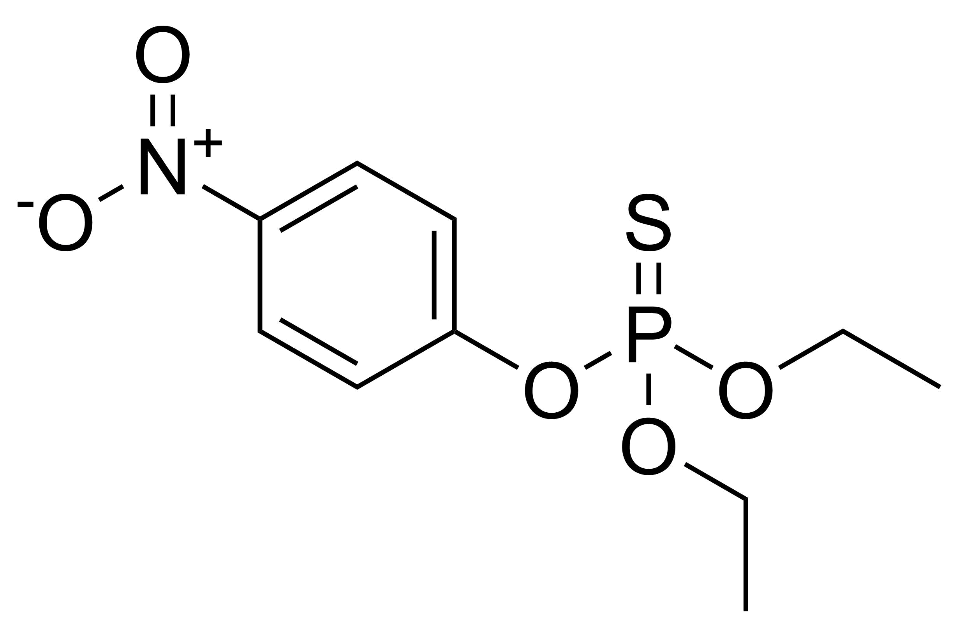
Parathion:
Synthesis
Uses:
Powerful insecticide used for fruit, cotton, wheat etc.
Used in form of smoke, aerosol and emulsion for crops.
  2 (C₂H₅O)₂P(S)SH + 3 Cl₂ → 2 (C₂H₅O)₂P(S)Cl + S₂Cl₂ + 2 HCl
  (C2H5O)₂P(S)Cl + NaOC₆H₄NO₂ → (C₂H₅O)₂P(S)OC₆H₄NO₂ + NaCl

Slide 9
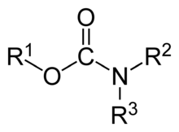
Carbamates
They are esters of carbamic acid. E.g. are carbofuran, carbaryl, ethienocarb etc.

Slide 10
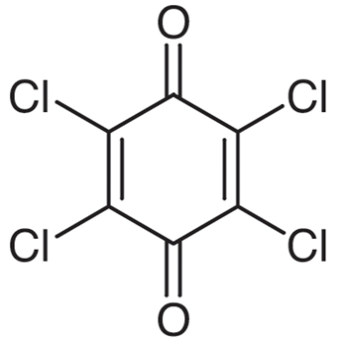
Quinones
Chloranil: It is a quinone.It is prepared by chlorination of o- and p- chlorophenols.
Uses:
Used to protect seeds and bulbs.
Very effective in control of downy mildew of broccoli, cauliflower and lettuce.

Slide 11
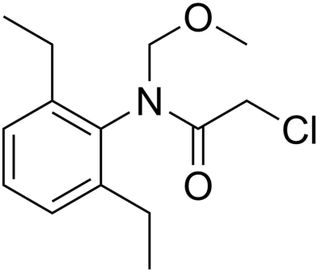
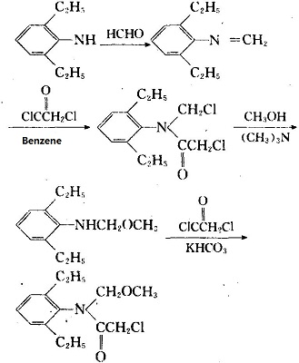
Anilides
Alachlor:
Synthesis of alachlor:

Slide 12
Uses of alachlor:
- As herbicide for the control of growth of annual grasses and broadleaf weeds primarily in corn, sorghum and soybeans crops.

Slide 13
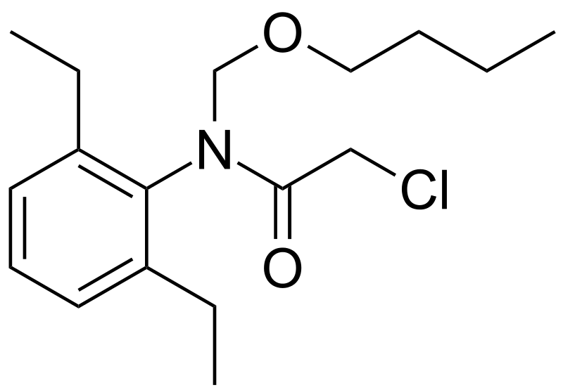
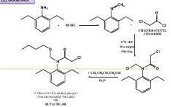
Butachlor:
Synthesis of butachlor:

Slide 14
Uses of Butachlor:
As pre-emergence control of unwanted weeds in vegetable, barley, cotton etc.
It is widely used in form of granules in rice crops to control the post emergence of weeds.

Slide 15
Thank You

